Slide 1



Amity – SKIDOS Hackathon 2.0
Team Members ( Gen-Z )
Danishan
Shitij Kumar
Abdullah Mohammad Yasir

Slide 2
Problem Statement :
Design an Application that can be used
to solve simple math problem
Take input either speech or text
Perform Multiplication
Division
Subtraction
Addition
GCD ( Greatest Common Multiple)
LCM (Least common multiple)

Slide 3
In order to solve the problem
Java as a core language to the program
Java Swing as Front-end or GUI
Stack (DSA)

Slide 4
Features
It has two Themes
It Can Perform
Addition
Subtraction
Multiplication
Division
GDC
LCM
Of two of More Numbers
It also can solve String of multiple number of different operation

Slide 5
Features
The App Start with Logo Screen.
It also Support the calculation with decimal numbers.
Default theme is Light theme.
It reflect the answer on getting every digit.
It is Single page app with three different Layout.

Slide 6
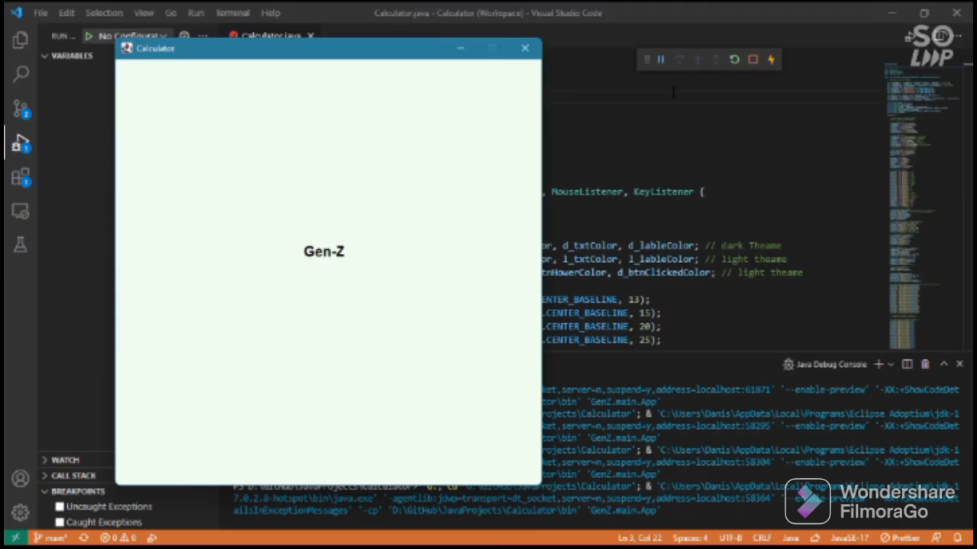

Slide 7
Thank You

